Slide 1
Statistics for Public Health Research
Center for Data Research and Analytics

Slide 2
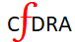
Session-1 Table of Content
Population and parameters
Research question
Quantification of a research question
Measuring the outcome
Collecting data for the study parameters
The other factors
Sample and Estimators
Inference vs generalizability
Random sample
Source of biases in sampling

Slide 3
Population
Population is the complete collection of objects
We define population on which we generalize our study findings

Slide 4
Parameter
Parameter are the measurable characteristic of the population

Slide 5
Research Question
The very first step of a scientific method of research
We ask question about the parameter of a population

Slide 6
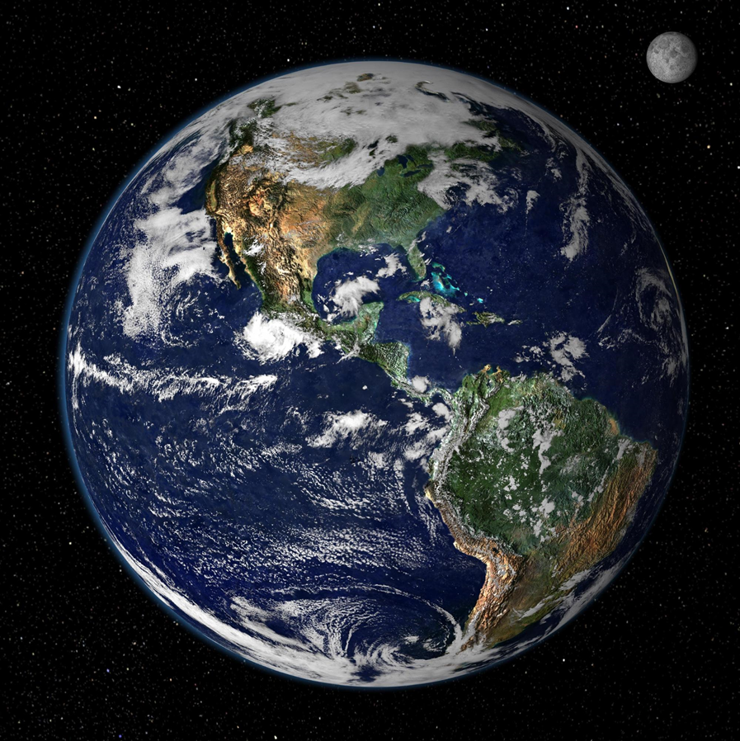
Population Example
Research Questions
What is the level of CO₂ concentration in the atmosphere in 2021
What causes CO₂ concentration increase over the last 10 years in the atmosphere?
The world atmosphere is the population for these research questions

Slide 7
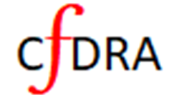
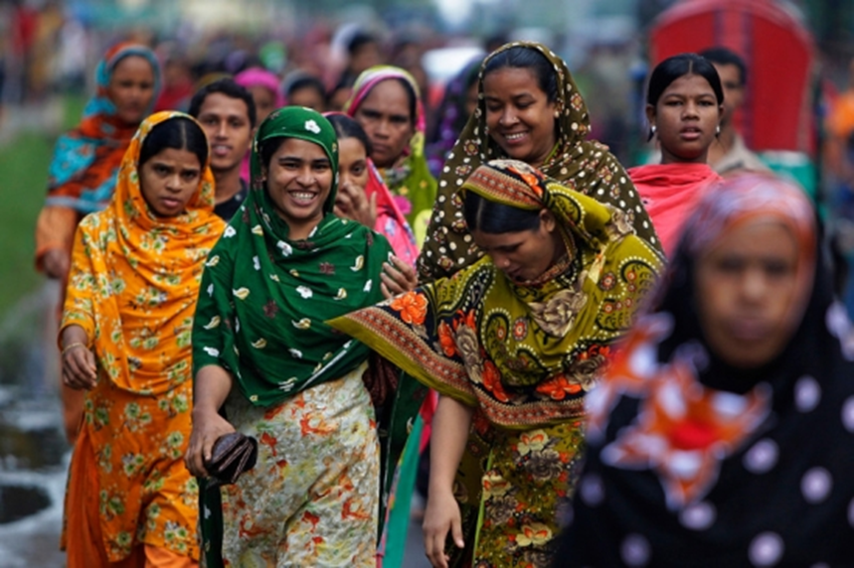
Population Example
Research Questions
What is the prevalence of breast cancer in Bangladesh in 2021
What are the main causes of breast cancer among women over age 40 in Bangladesh
The population consists of all females in Bangladesh who are at risk of breast cancer

Slide 8
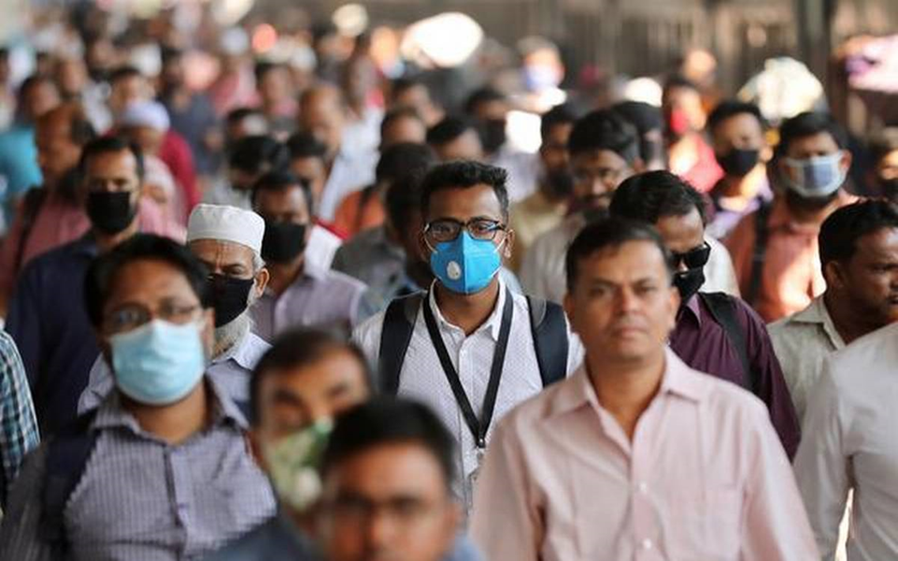
Population Example
Research Questions
What is the prevalence of prostate cancer in Bangladesh?
What is the risk of prostate cancer among Bangladeshi males?
What are the risk factors for the prostate cancer?
Which age male are at most risk of prostate cancer in Bangladesh?
The population consists of all males of Bangladeshwho are at risk prostate cancer.

Slide 9
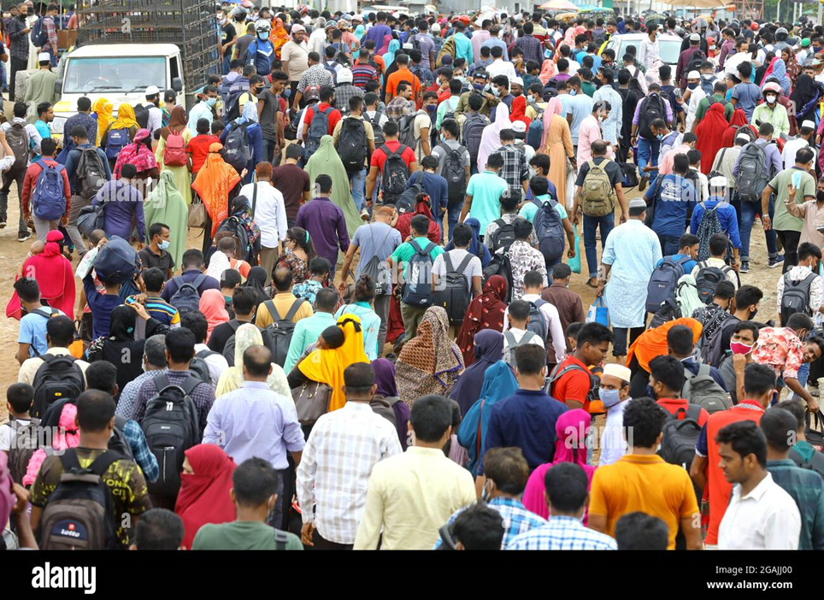
Population Example
Research Questions
What is the COVID-19 incidence rate in Bangladesh in 2021
What is the risk factors for COVID-19 infection in Bangladesh
Which age group is most likely to get COVID-19 in Bangladesh
How many people are need to be vaccinated to control the spread of COVID-19 in Bangladesh
The population consists of all people in Bangladesh who are at risk of COVID-19

Slide 10
Quantification of Research Questions
The numbers needed for the parameter

Slide 11
Collecting Data for the Study Parameters

